Slide 1

MYERS-BRIGGS PREDICTION MODEL
DAVENEL DENIS | JING JIN | STEVEN WALK | SHAUN WANG

Slide 2
Contents
Background
1
Data analysis
2
Machine Learning Models
3
The topic, our objective, data source
Database, data exploration, assumption validation, data cleaning
Methodology, model selection, model evaluation

Slide 3
Contents
Results and looking forward
4
Interactive Application
5
About the creators
6
Which model we select, and why. How we can improve the processes in the future
The objective, the functions, connection and design
Brief bio, what we learned from the project

Slide 4
Background
What is the Myers-Briggs Type Indicator (MBTI), and why measure it?

Slide 5

Personality
Myers-Briggs Type Indicator (MBTI) is one of the most prevalent personality tests in the world. Its purpose is to categorize psychological profiles based on the assumption that variations in everyday behavior are ordered, consistent, and capable of being categorized. Currently, the MBTI test is performed by an online quiz.

Slide 6
The Problem with the quiz
The quiz often includes intrinsic biases because the subject is conscious of the quiz processes and will answer accordingly.
Therefore, we wanted to create a more objective process for testing MBTI.
By inputting writing from the subject, we hope to train a machine learning model to predict their personality category through text analytics. Hopefully, this will eliminate input biases from the subject.

Slide 7
Description of the Data Source
The Myers-Briggs Type Indicator (MBTI) is a taxonomy that divides everyone into 16 distinct personality types across four axes:
Introversion (I) – Extroversion (E)
Intuition (N) – Sensing (S)
Thinking (T) – Feeling (F)
Judging (J) – Perceiving (P)
The dataset contains ~ 8,600 observations (people), where each observation gives a person’s:
Myers-Briggs personality type (as a four-letter code)
An excerpt containing the last 50 posts on their PersonalityCafe forum (each entry separated by “|||”)
** This data was collected through the PersonalityCafe forum, as it provides a large selection of people and their MBTI personality types, as well as what they have written.

Slide 8

Questions we want to solve with the data
Explore and analyze the data to see if any patterns can be detected in specific types and their style of writing.
Create a Machine Learning model that is able to predict the personality type based on the writing input, so the quiz taker bias is removed.

Slide 9
2. Data Analysis
All about the data.

Slide 10
2.1 Database setup
AWS RDS
Postgres
SQLAlchemy
Set up RDS instance on AWS, and connect it to PostgreSQL.
Create new server with RDS as the host.
Create SQL table and import data in csv format.
Set up connection with Postgres database.
Reads in the table as a Pandas Dataframe.

Slide 11
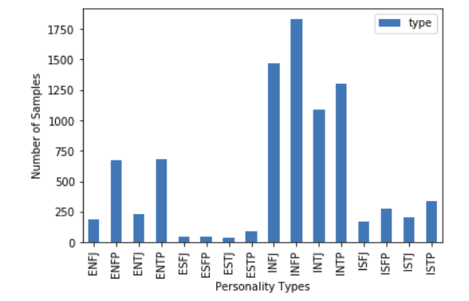
2.2 Data Exploration
A personality type count shows that the sample data is not very evenly distributed.
Four data types, INFJ, INFP, INTJ, INTP has extremely larger samples (over 1,000), compared to ESFJ, ESFP, ESTJ, ESTP (fewer than 250).
The users from the forum tend to be IN?? type.

Slide 12
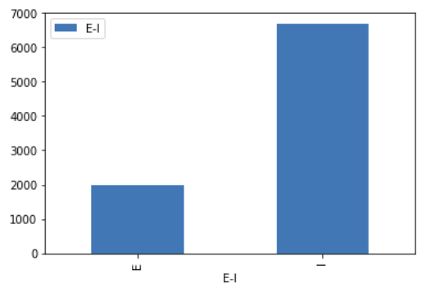
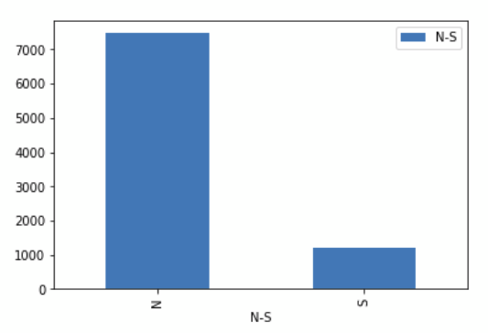
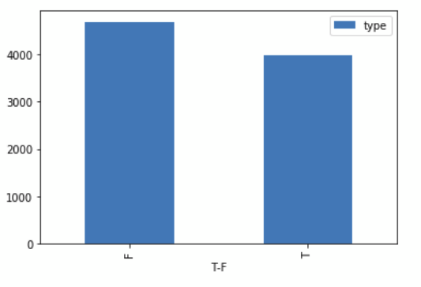
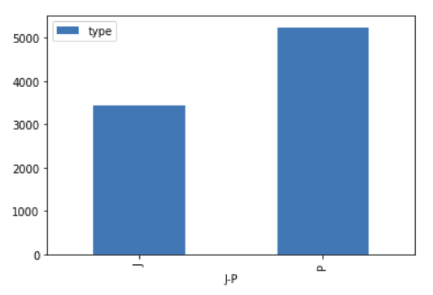
2.2 Data Exploration
Comparing the sample sizes within each of the four axes, we can see that the E-I and N-S axes have extremely imbalanced sample sizes.

Slide 13
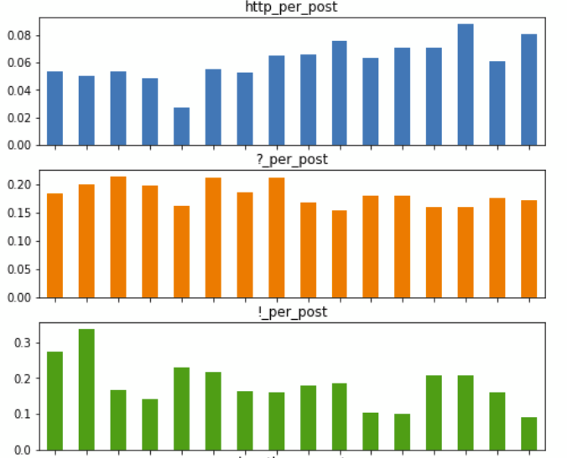
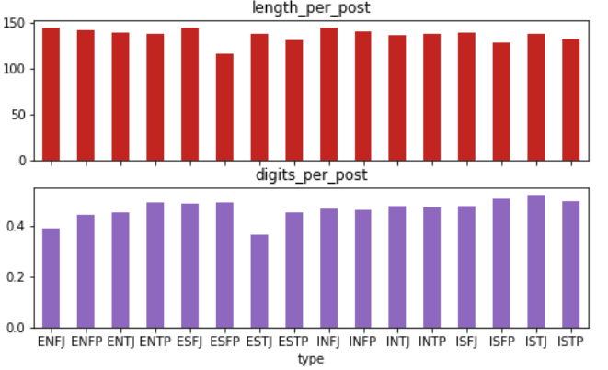
2.2 Data Exploration
The use of exclamation marks and http links differ slightly among the groups. Other writing style counts tend to be fairly evenly distributed.

Slide 14
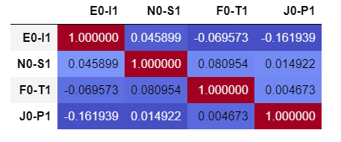
2.3 Assumption Validation
There are 16 possible personality types to predict, and this limits our choice in various Machine Learning models.
We proposed dividing the personality types into four axes (E-I, N-S, F-T, J-P). In this way, our model only needs to output a binary result. This greatly enlarged our selection of models.
Before going forward, we need to test the assumption that each of the four axes are independent from the others.
A correlation matrix is produced, as shown in the figure on the left:
Overall, the correlations’ absolute values are < 0.2, indicating low correlation.
‹#›

Slide 15
2.4 Data Cleaning
Used RegEx methodology to clean data that consisted of social media posts from over 8,000 unique identifiers with 50 mposts each separated by 3 pipes ( ||| ).
Reading the mood from text with ML is called “sentiment analysis.” However, before we could perform sentiment analysis, we had to create a column without the following: http strings, ||| strings, punctuation marks, underscores, numbers, one letter words, and leftover white space.
Then, we made everything lowercase.
We decided that because we are trying to capture personality types, we wanted the text as similar to the actual writing as possible; this is part art and part science.
We then tokenized and performed TF-IDF vectorization for all four models.

Slide 16
3. Machine Learning Models
What were our four processes, their advantages, and their disadvantages?

Slide 17
Alternative
ML Models
Logistic Regression: Uses sigmoid curve to produce binary prediction. Works better with smaller data size and simpler features.
Neural Network: Set of algorithms, modeled loosely after the human brain, that are designed to recognize patterns. They interpret sensory data through a kind of machine perception, labeling or clustering raw input.
Random Forest: Good fit for our data structure (tabular). It can produce a result much faster compared to Neural Network model.
SVC: Requires the features to be straight forward. Works well in classifying into two groups.

Slide 18

1. Logistic Regression
Uses sigmoid curve to produce binary prediction. Works better with smaller data size and simpler features.

Slide 19
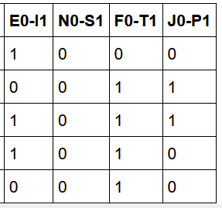
The Process
The cleaned text data contains neither digits nor special characters.
The personality type column is split into four columns (axes) and encoded to 1 and 0 values, in order to run the model on four different axes (Y).
We split the text data and four target axes into training and testing, with a random state of 42.
The text data (training and testing) are vectorized to 17,000 features using TFIDF vectorizer. All 17,000 vectors are used as features (X).
Logistic regression model is created from sklearn package, with solver set to ‘lbfgs.’
Before running the model, the encoded y columns are split into four separate training-testing sets. Each marked as EI, NS, FT, JP for clearer recognition.
The logistic regression model is run four times, each time with the same X features, but four different y to predict the personality type on each axis.
We can get the predicted personality type by combining the result from the four models.

Slide 20
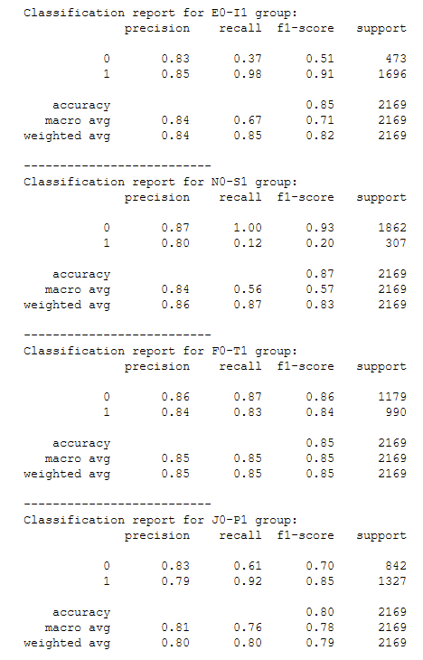
The Result
Accuracy score for each group is around 0.8, which is a fairly good result.
The F1-score varies greatly from group to group, with the highest at 0.93 and lowest at 0.20.
This could be the result of class imbalance as shown in the EDA process.
The logistic regression model is a linear classifier, separating the group to two groups. It works well with a simple and small dataset. Since our model has 17,000 features and over 8,000 observations, logistic regression may not be the best model for our dataset.
‹#›

Slide 21

2. Neural Network
How did we run the neural network?

Slide 22
The Process
The cleaned text data contains neither digits nor special characters.
The text data (training and testing) are vectorized to 17,000 features using TFIDF vectorizer. All 17,000 vectors are used as features (X).
Neural network model is created from sklearn package, for TFidfVectorizer, train test split, LabelEncoder and hidden nodes layers set to 24 and 12 respectively.
The first and second hidden layers; the activation performed using ReLu.
The output layer activation was performed using SoftMax and then we compiled the sequential model together and customized the metrics.
Trained the model using 50 epochs and then evaluated using the test data.
The results were given for 50 epochs and 100 epochs.

Slide 23
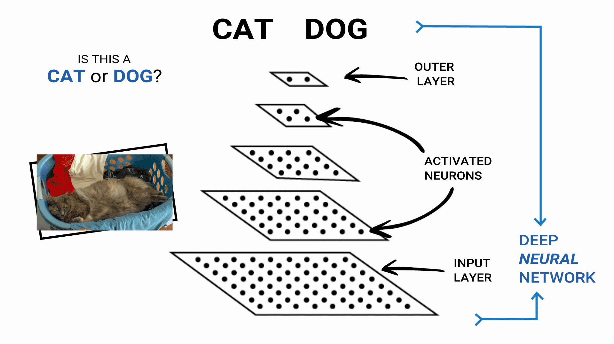
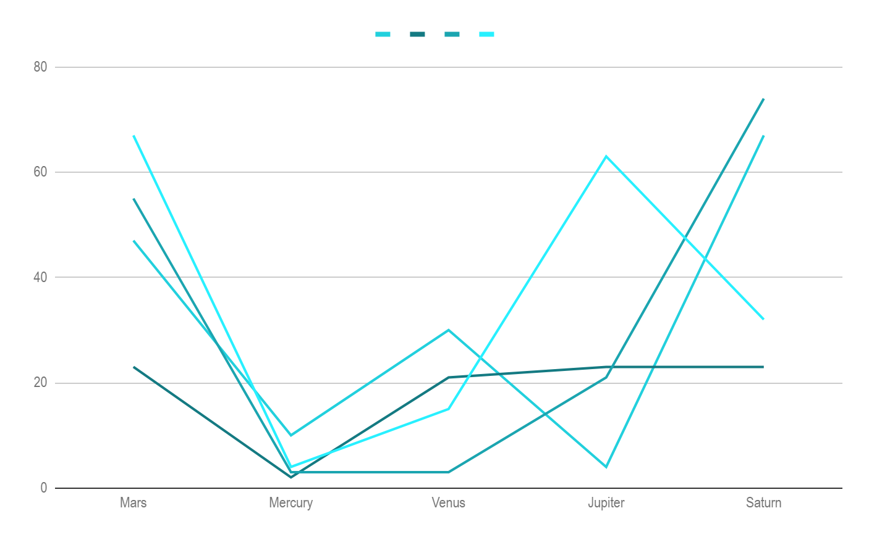
The Result
If you want to modify this graph, click on it, follow the link,
change the data and replace it
50 epochs:
2169/1 - 1s - loss: 4.2617 - accuracy: 0.5090
Loss: 3.3364757154877145, Accuracy: 0.5089903473854065
100 epochs:
2169/1 - 1s - loss: 6.9419 - accuracy: 0.5390
Loss: 4.63548002599186, Accuracy: 0.5389580726623535
‹#›

Slide 24
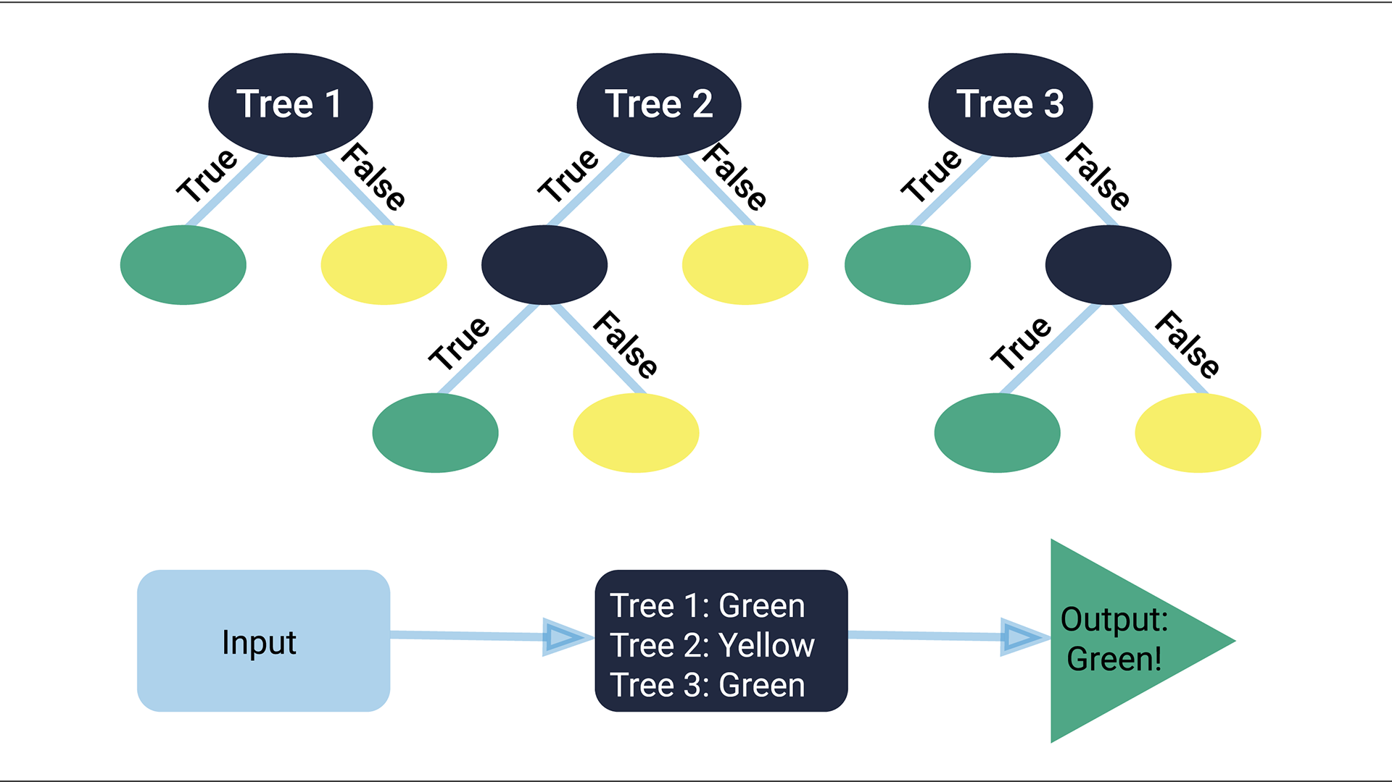
3. Random Forest

Slide 25
The Process
The cleaned text data contains neither digits nor special characters.
The personality type column is split into four columns (axes) and encoded to 1 and 0 values, in order to run the model on four different axes (Ys).
We split the text data and four target axes into training and testing, with random state of 0.
The text data (training and testing) are vectorized to 17,000 features using TFIDF vectorizer. All the 17,000 vectors are used as features (X).
Random Forest model is set to an n_estimator of 1,000 .
Before running the model, the encoded y columns are split into four separate training-testing sets. Each marked as EI, NS, FT, JP for clearer recognition.
The Random Forest model is run four times, each time with the same X features, but four different y features to predict the personality type on each axis.
We can get the predicted personality type by combining the result from the four models.

Slide 26
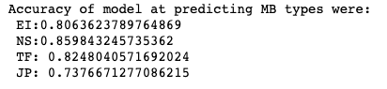
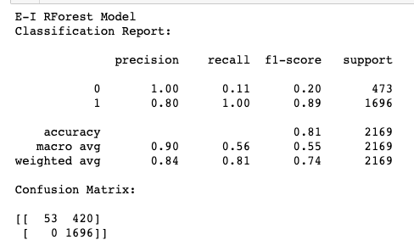
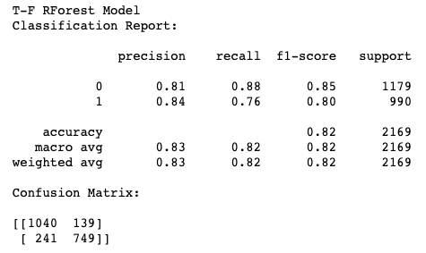
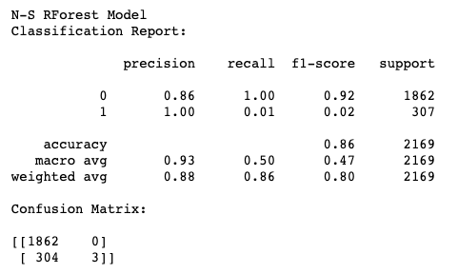
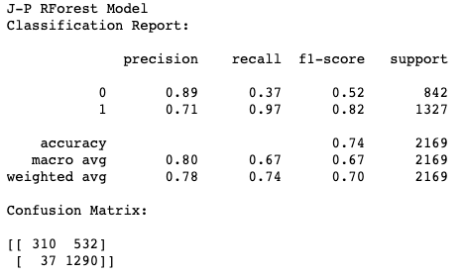
The Result
Random Forest algorithms are beneficial because they:
Are robust against overfitting as all of those weak learners are trained on different pieces of the data.
Can be used to rank the importance of input variables in a natural way.
Can handle thousands of input variables without variable deletion.
Are robust with regards to outliers and nonlinear data.
Run efficiently on large datasets.
However, the results from the Random Forest:
Some of the F1 scores were very low, and did not formally compute into desires metrics.
It underperformed in many areas due to sample size of the data.
‹#›

Slide 27
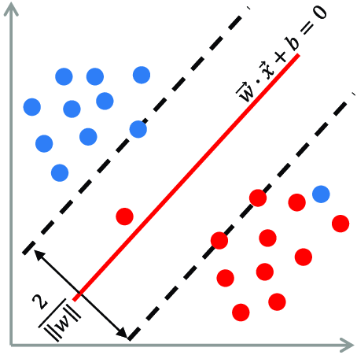
4. SVC
How did we calibrate our support vector machine?

Slide 28
The Process
The cleaned text data contains neither digits nor special characters.
The personality type column is split into four columns (axes) and encoded to 1 and 0 values, in order to run the model on four different axes (Y).
We split the text data and four target axes into training and testing, with random state of 42.
The text data (training and testing) are vectorized to 17,000 features using TFIDF vectorizer. All the 17,000 vectors are used as features (X).
LinearSVC model is created from sklearn package, with solver set to ‘lbfgs.’
Before running the model, the encoded y columns are split into four separate training-testing sets. Each marked as EI, NS, FT, JP for clearer recognition.
The LinearSVC model is run four times, each time with the same X features, but four different y features to predict the personality type on each axis, where parameters are specified for better accuracy (random_state=0, max_iter=2000, C=.79)
We can get the predicted personality type by combining the result from the four models.

Slide 29
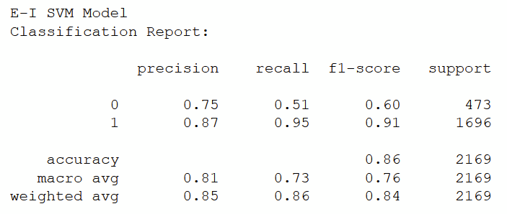
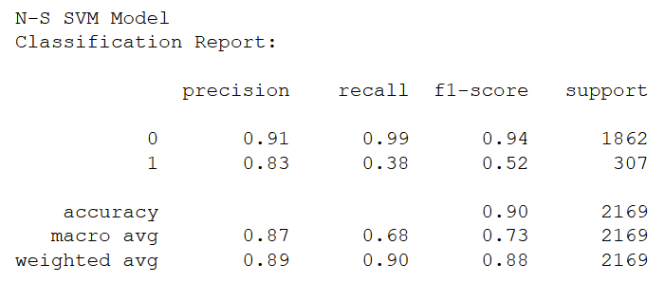
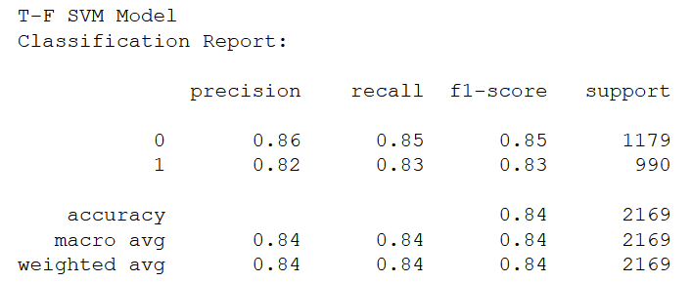
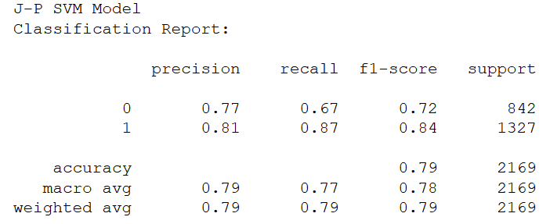
The Result
The overall accuracy is good, around 0.80.
F1-scores vary from group to group; The highest is 0.94 and the lowest is 0.52.
This difference in performance can be the result of class imbalance of the E-I and N-S group.
However, this imbalance can be amended by resampling and is due to data bias rather than the model.
‹#›

Slide 30
4. Results and
looking forward
What did we learn, and where do we go from here?

Slide 31
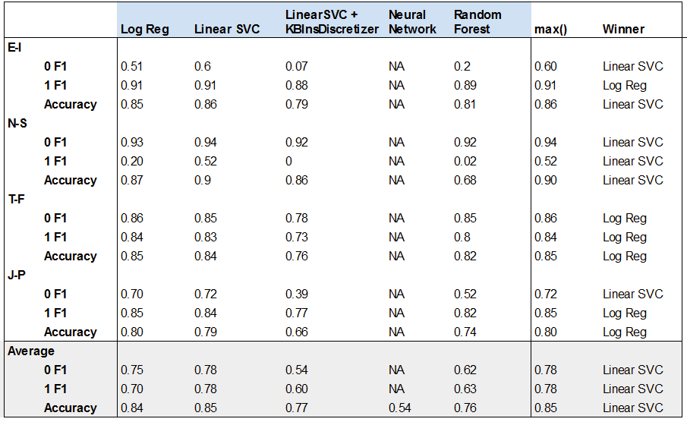
Model Comparison

Slide 32
Our choice of model - linearSVC
Linear SVC model produces the highest f1 scores and average accuracy.
It also makes sense since we are producing a binary result for every dimension. SVC works well with tabular data and classifying into two groups. It is also better in capturing the bigger picture.

Slide 33
Next Steps and Points to improve
At current stage of the project, we discovered a few points we can improve in the future:
The class imbalance for the E-I and N-S axes. This can be solved with a resampling of the dataset.
We can continue to tweak the model parameters to improve the accuracy
Currently we are 100% relying on TFIDF for the features. We could try generating our own features and use those as the input of our model.
We can make our frontend more appealing in terms of content, styling and creative elements.

Slide 34
5. Interactive Application
Now it’s your turn!

Slide 35
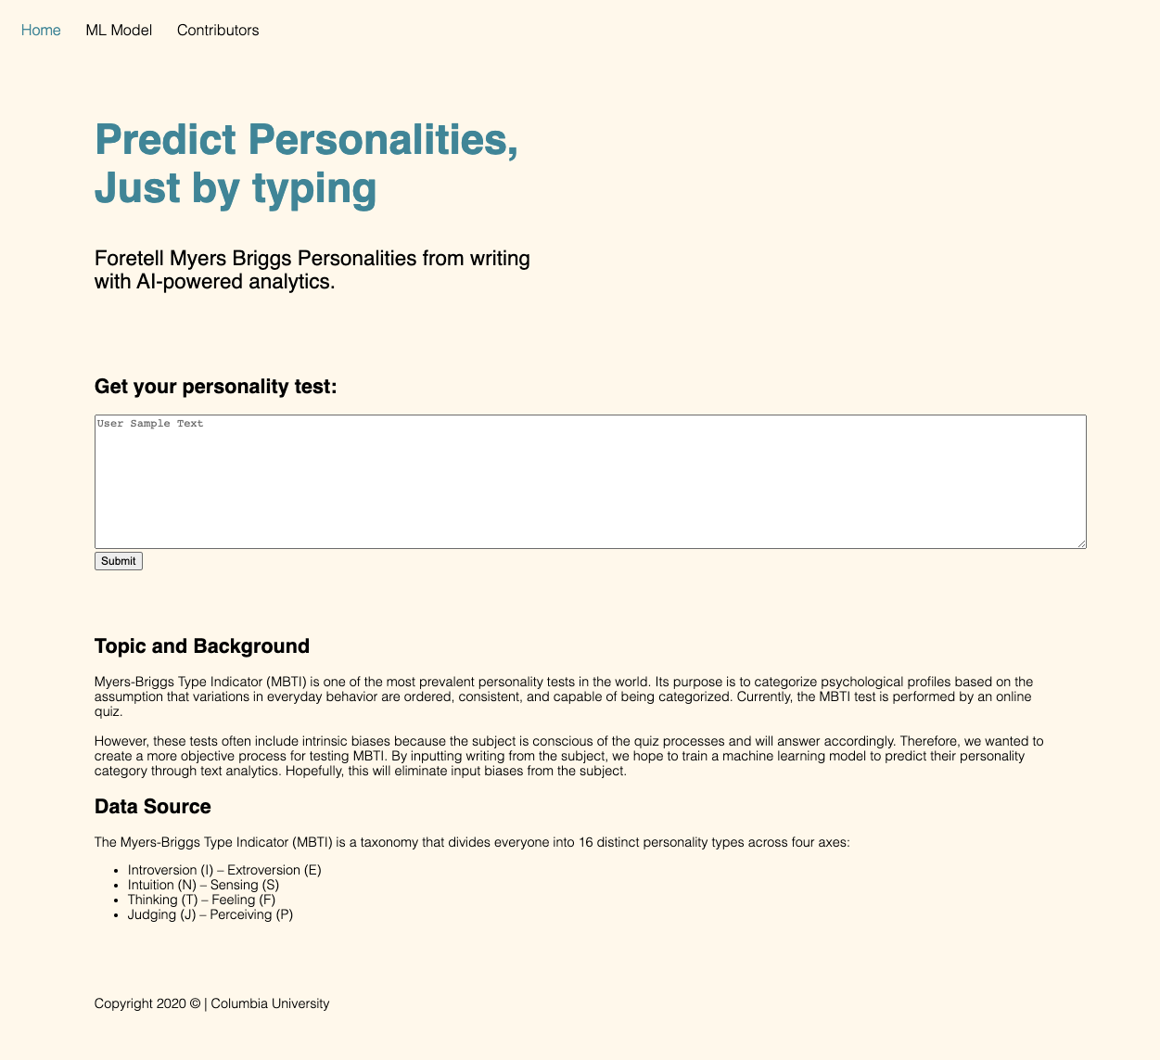
Front-End
Preview
‹#›

Slide 36

The Application
The front-end allows the user to input some of their writings or recent posts on social media.
The text is taken from the input box, cleaned and goes through the ML model to produce the personality result.
The final result is then printed on the front-end to share with the user.

Slide 37
6. About the creators
Who are we?

Slide 38
Talk about your TEAM
DAVENEL DENIS
JING JIN
STEVEN WALK
SHAUN WANG

Slide 39
Thanks!
Does anyone have any questions?
Github: https://github.com/shaunwang1350/MyersBriggsMLProject

